Slide 1
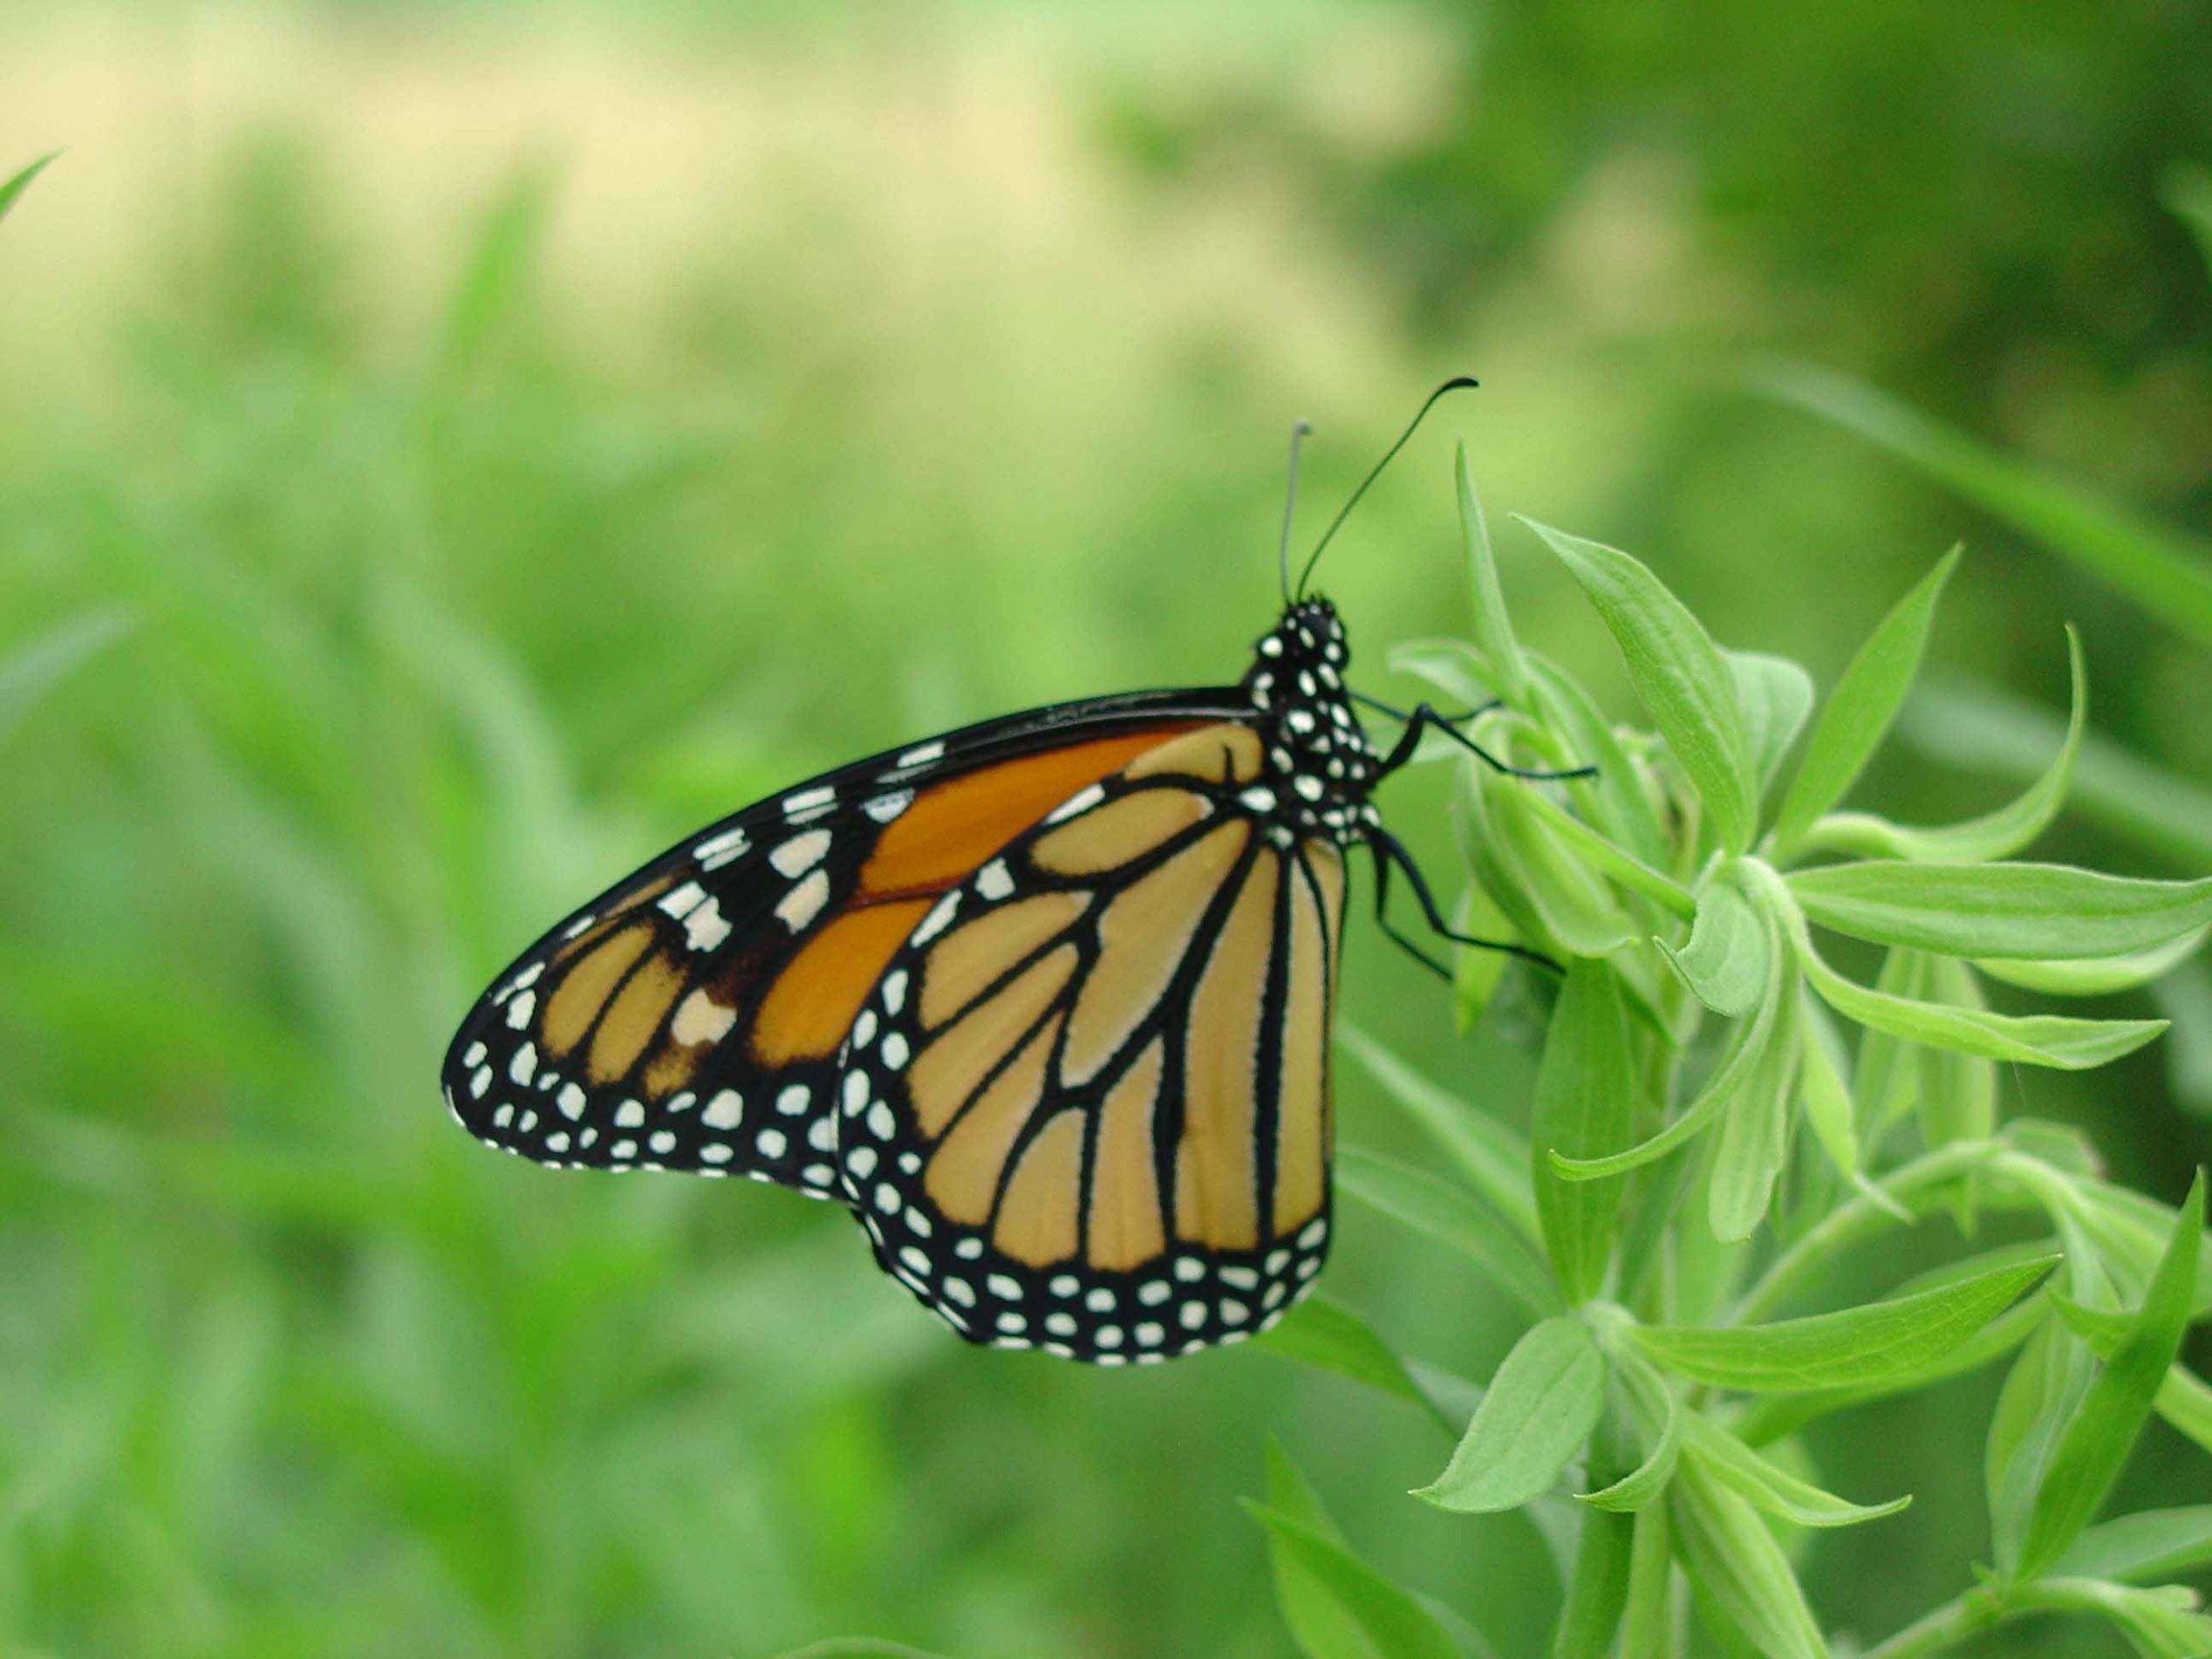
Monarch Migration Analysis
Samantha Goodman
Google Data Analytics Case Study
January, 2022

Slide 2

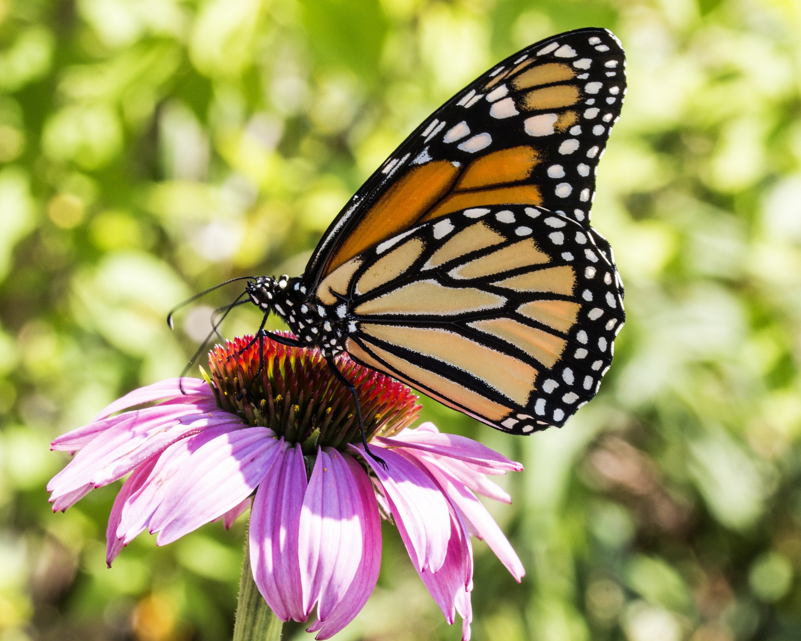
Background
Eastern monarchs butterflies (Danaus plexippus) leave their overwintering sites in the mountains of Mexico each spring
They spend the summer traveling north and breeding
After 2-3 generations, and starting in August, the monarch population travels south to return to the overwintering site

Slide 3
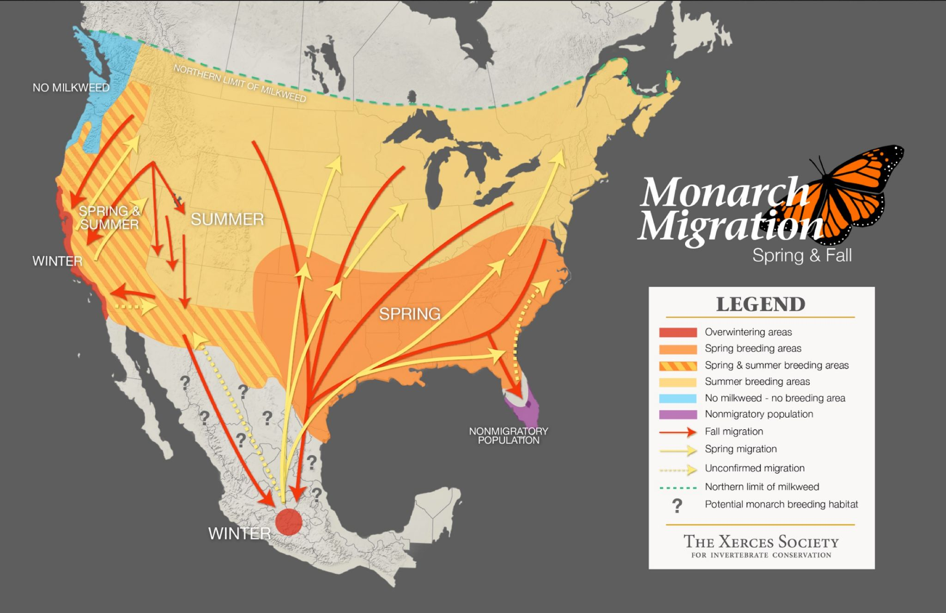

Slide 4
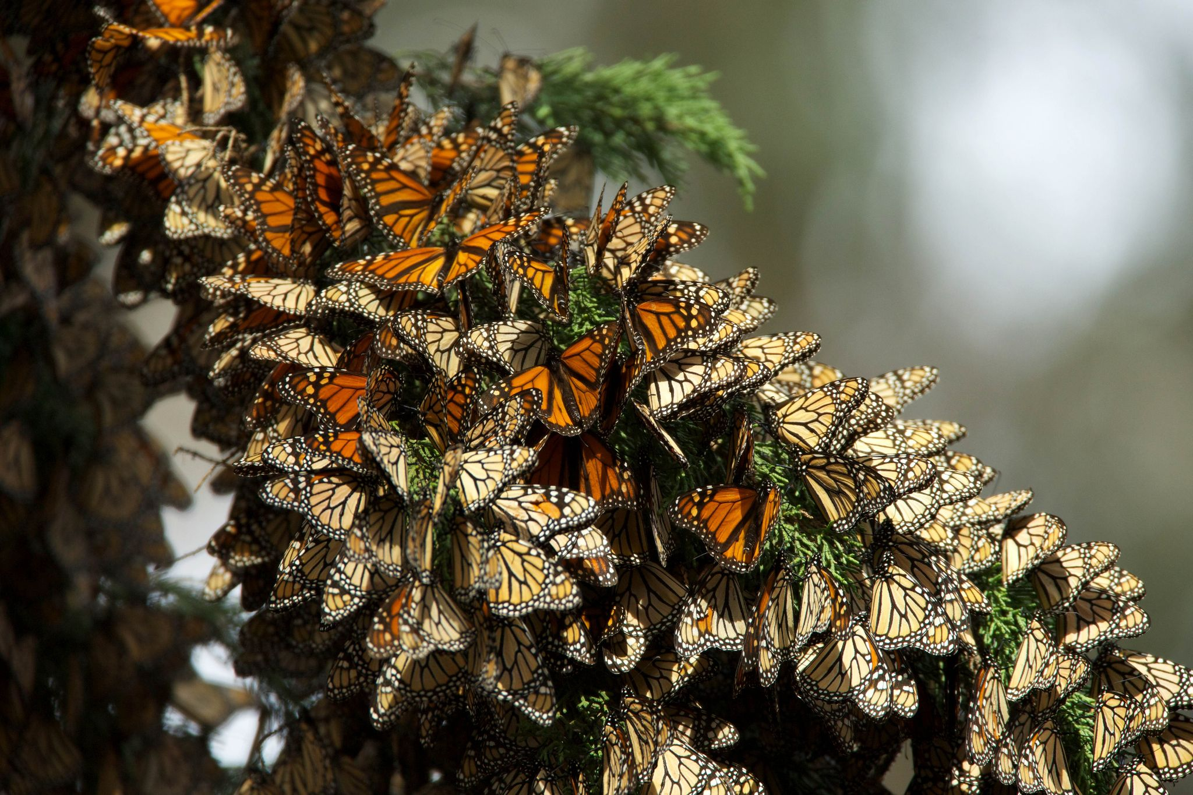
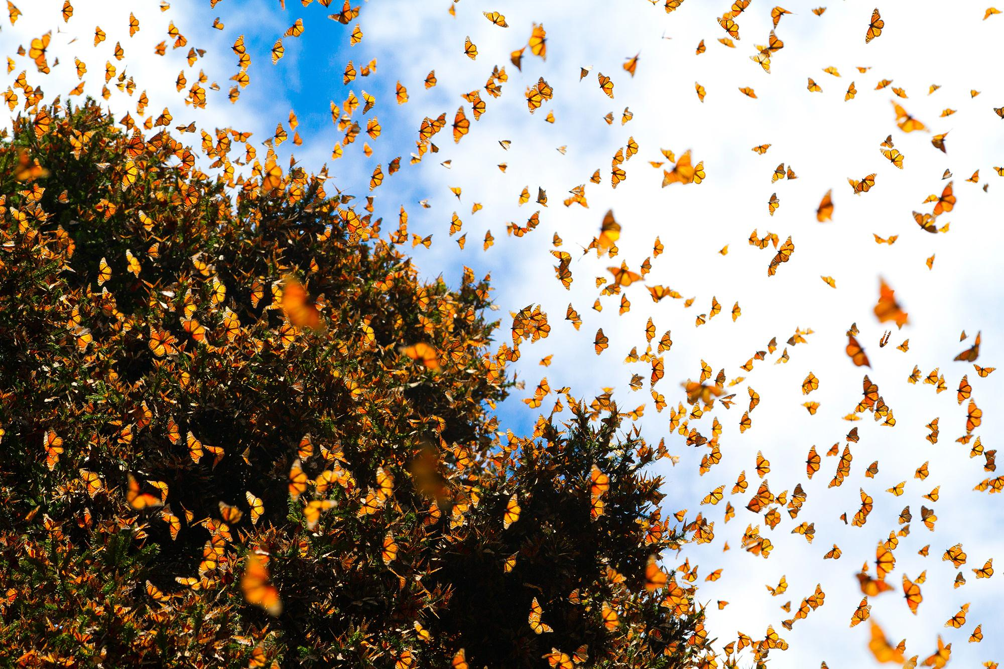
Data Source
Citizen scientists submit monarch observations to Journey North (https://journeynorth.org/)
Many types of observations are submitted
I focused on Roosts and Peak Migration Events

Slide 5
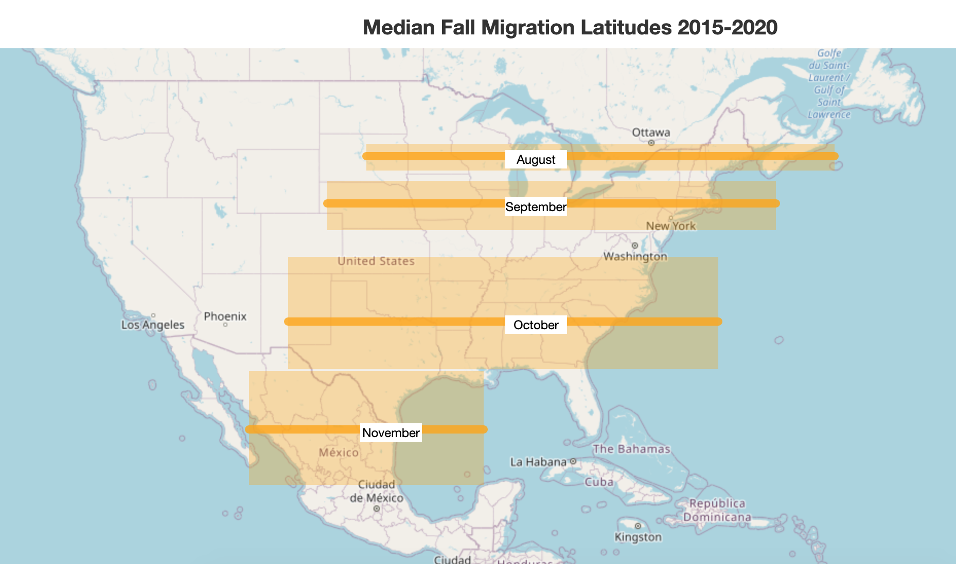
My Analysis
The map shows the median latitude for that month (solid orange line) and the quartiles Q1-Q3 inside the light orange areas
50% of the observations for each month fall within the shaded area

Slide 6
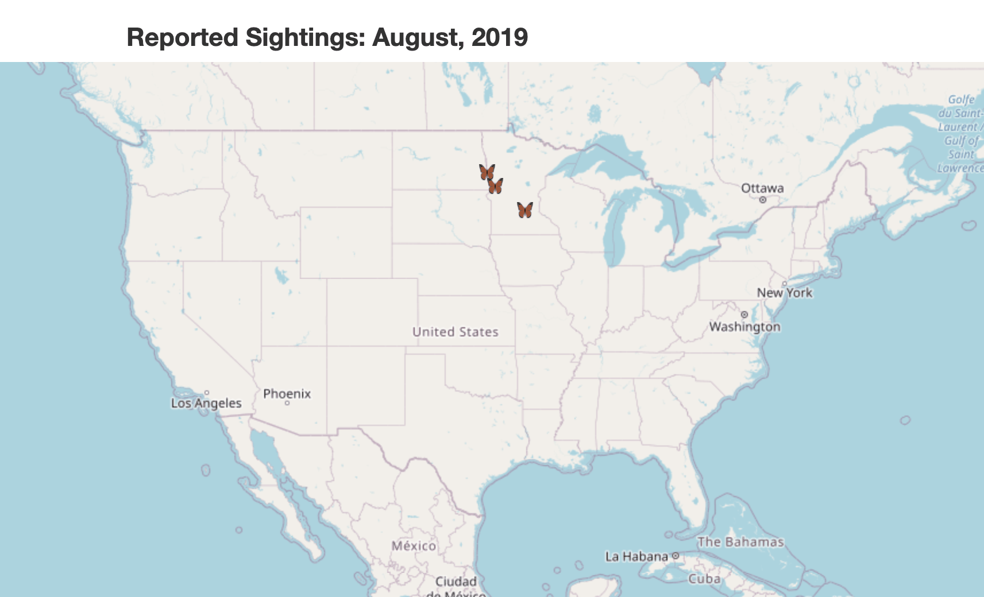
Animated Gif
I created an animated gif showing the monarch migration for one season (Fall 2019)
Available online here

Slide 7
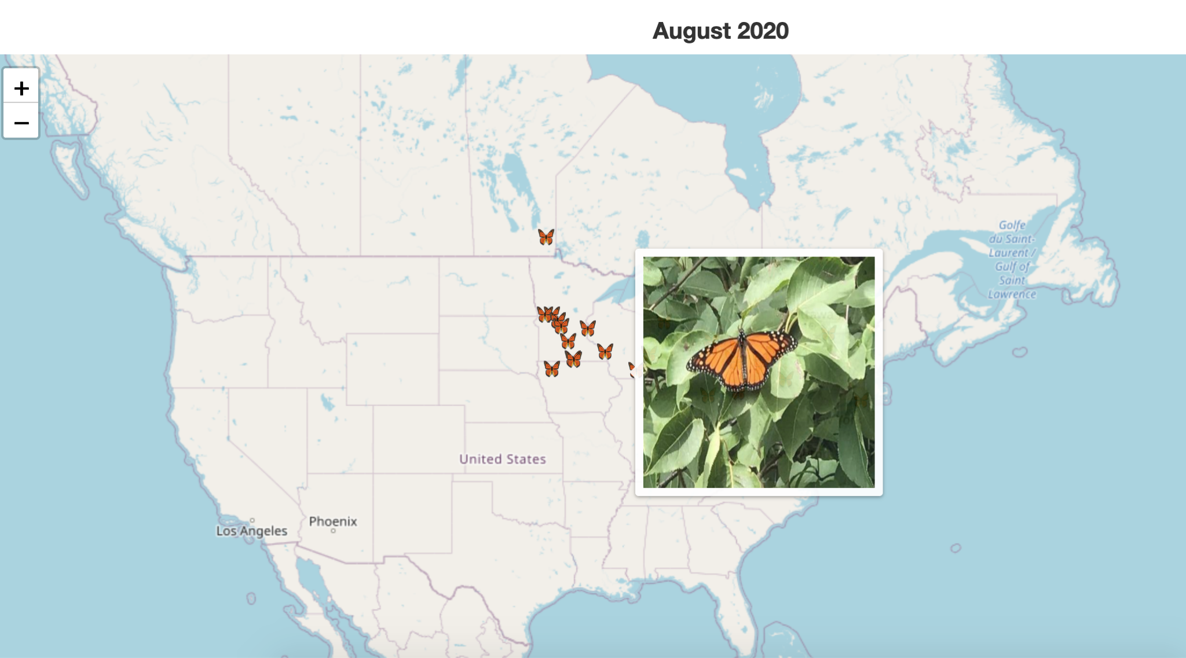
Interactive Map
I created an interactive maps showing reported migration events for a few months of 2020
Available here:
August 2020
September 2020

Slide 8
Limitations
All of the observations are submitted by volunteers, and thus prone to errors
This was not a longitudinal study, so it was not possible to compare year to year - observations submitted over time have increased, but likely due to popularity of Journey North increasing, not monarch butterfly population increase

